Slide 1

Chapter 3 RDF Schema

Slide 2
Introduction
RDF has a very simple data model
RDF Schema (RDFS) enriches the data model, adding vocabulary & associated semantics for
Classes and subclasses
Properties and sub-properties
Typing of properties
Support for describing simple ontologies
Adds an object-oriented flavor
But with a logic-oriented approach and using “open world” semantics

Slide 3
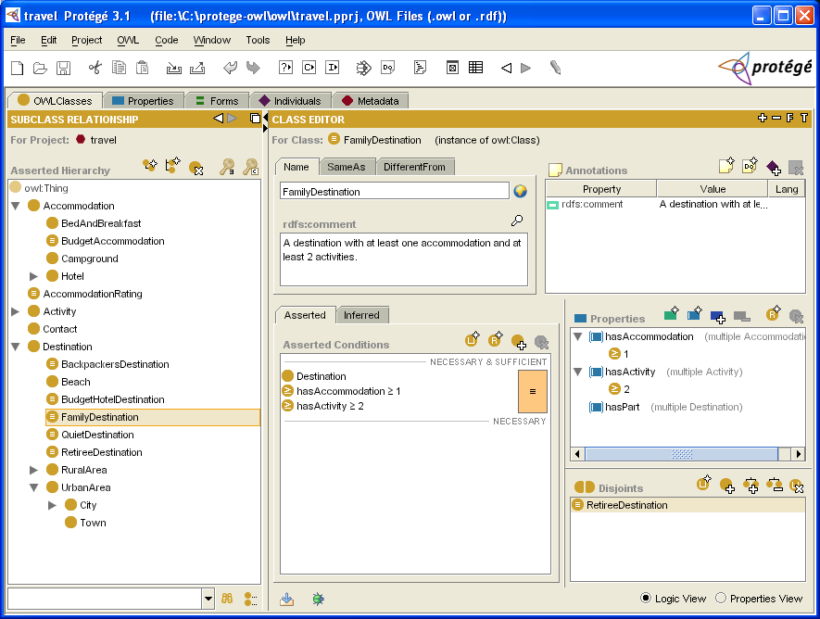
RDFS is a simple KB Language
Several widely used Knowledge-Base tools can import and export in RDFS, including Stanford’s Protégé KB editor

Slide 4
RDFS Vocabulary
RDFS introduces the following terms, giving each a meaning w.r.t. the rdf data model
Terms for classes
rdfs:Class
rdfs:subClassOf
Terms for properties
rdfs:domain
rdfs:range
rdfs:subPropertyOf
Special classes
rdfs:Resource
rdfs:Literal
rdfs:Datatype
Terms for collections
rdfs:member
rdfs:Container
rdfs:ContainerMem-bershipProperty
Special properties
rdfs:comment
rdfs:seeAlso
rdfs:isDefinedBy
rdfs:label
@PREFIX rdfs: <http://www.w3.org/2000/01/rdf-schema#>

Slide 5
Modeling the semantics in logic
We could represent any RDF triple with a binary predicate in logic, e.g.
type(john, human) age(john, 32) subclass(human, animal)
But traditionally we model a class or type as a unary predicate
human(john) age(john, 32) subclass(human, animal)

Slide 6
Classes and Instances
We distinguish between
Concrete “things” (individual objects) in the domain: Discrete Math, Richard Chang, etc.
Sets of individuals sharing properties called classes: lecturers, students, courses etc.
Individual objects belonging to a class are referred to as instances of that class
Relationship between instances and classes in RDF is through rdf:type
Note similarity to classes and objects in an OO prog. language (but RDF classes stand for sets)

Slide 7
Classes are Useful
Classes let us impose restrictions on what can be stated in an RDF document using the schema
As in programming languages
E.g., A+1, where A is an array
Disallow nonsense from being stated by detecting contradictions
Allow us to infer a type of an object from how it is used -- like type inference in a programming language

Slide 8
Preventing nonsensical Statements
Discrete Math is taught by Calculus
We want courses to be taught by lecturers only
Restriction on values of the property “is taught by” (range restriction)
Room ITE228 is taught by Richard Chang
Only courses can be taught
This imposes a restriction on the objects to which the property can be applied (domain restriction)

Slide 9
Class Hierarchies
Classes can be organized in hierarchies
A is a subclass of B if and only if every instance of A is also an instance of B
We also say that B is a superclass of A
The subclass graph needn’t be a tree
A class may have multiple superclasses
In logic:
subclass(p, q) ⬄ p(x) => q(x)
subclass(p, q) ∧ p(x) => q(x)

Slide 10
Domain and Range
The domain & range properties let us associate classes with a property’s subject and object
Only a course can be taught
domain(isTaughtBy, course)
Only an academic staff member can teach
range(isTaughtBy, academicStaffMember)
Semantics in logic:
domain(pred, aclass)∧pred(subj, obj) => aclass(subj)
range(pred, aclass)∧pred(subj, obj) => aclass(obj)

Slide 11
Property Hierarchies
Hierarchical relationships for properties
E.g., “is taught by” is a subproperty of “involves”
If a course C is taught by an academic staff member A, then C also involves Α
The converse is not necessarily true
E.g., A may be the teacher of the course C, or a TA who grades student homework but doesn’t teach
Semantics in logic
subproperty(p, q) ∧ p(subj, obj) => q(sub,obj)
e.g, subproperty(mother,parent), mother(p1, p2) => parent(p1, p2)

Slide 12
RDF Layer vs. RDF Schema Layer
Discrete Math is taught by Richard Chang
The schema is itself written in a formal language, RDF Schema, that can express its ingredients:
subClassOf, Class, Property, subPropertyOf, Resource, etc.

Slide 13
RDF Schema in RDF
RDFS’s modelling primitives are defined using resources and properties (RDF itself is used!)
To declare that “lecturer” is a subclass of “academic staff member”
Define resources lecturer, academicStaffMember, and subClassOf
define property subClassOf
Write triple (subClassOf, lecturer,academicStaffMember)

Slide 14
Core Classes
rdfs:Resource: class of all resources
rdfs:Class: class of all classes
rdfs:Literal: class of all literals (strings)
rdf:Property: class of all properties
rdf:Statement: class of all reified statements

Slide 15
Core Properties
rdf:type: relates a resource to its class
The resource is declared to be an instance of that class
rdfs:subClassOf: relates a class to one of its superclasses
All instances of a class are instances of its superclass
rdfs:subPropertyOf: relates a property to one of its superproperties

Slide 16
Core Properties
rdfs:domain: specifies domain of property P
The class of those resources that may appear as subjects in a triple with predicate P
If domain not specified, any resource can be subject
rdfs:range: specifies range of a property P
The class of those resources that may appear as object in a triple with predicate P
If range not specified, any resource can be object

Slide 17
Examples (in Turtle)
:lecturer a rdfs:Class;
rdfs:subCLassOf :staffMember .
:phone a rdfs:Property;
rdfs:domain :staffMember;
rdfs:range rdfs:Literal .

Slide 18
Relationships: Core Classes & Properties
rdfs:subClassOf and rdfs:subPropertyOf are transitive, by definition
rdfs:Class is a subclass of rdfs:Resource
Because every class is a resource
rdfs:Resource is an instance of rdfs:Class
rdfs:Resource is class of all resources, so it is a class
Every class is an instance of rdfs:Class
For the same reason

Slide 19
Subclass Hierarchy of RDFS Primitives
rdfs:subClassOf
rdfs:subClassOf
rdfs:subClassOf
rdfs:subClassOf
rdfs:subClassOf
arrows represent the rdfs:subClassOf relation

Slide 20
Instance Relationships of RDFS Primitives
rdf:type
rdf:type
rdf:type
rdf:type
rdf:type
rdf:type
arrows represent the rdf:type relation

Slide 21
RDF and RDFS Property Instances
rdf:type
rdf:type
rdf:type
rdf:type
rdf:type
arrows represent the rdf:type relation

Slide 22
Reification and Containers
rdf:subject: relates a reified statement to its subject
rdf:predicate: relates a reified statement to its predicate
rdf:object: relates a reified statement to its object
rdf:Bag: the class of bags
rdf:Seq: the class of sequences
rdf:Alt: the class of alternatives
rdfs:Container: a superclass of all container classes, including the three above

Slide 23
Utility Properties
rdfs:seeAlso relates a resource to another resource that explains it
rdfs:isDefinedBy: a subproperty of rdfs:seeAlso that relates a resource to the place where its definition, typically an RDF schema, is found
rfds:comment. Comments, typically longer text, can be associated with a resource
rdfs:label. A human-friendly label (name) is associated with a resource

Slide 24
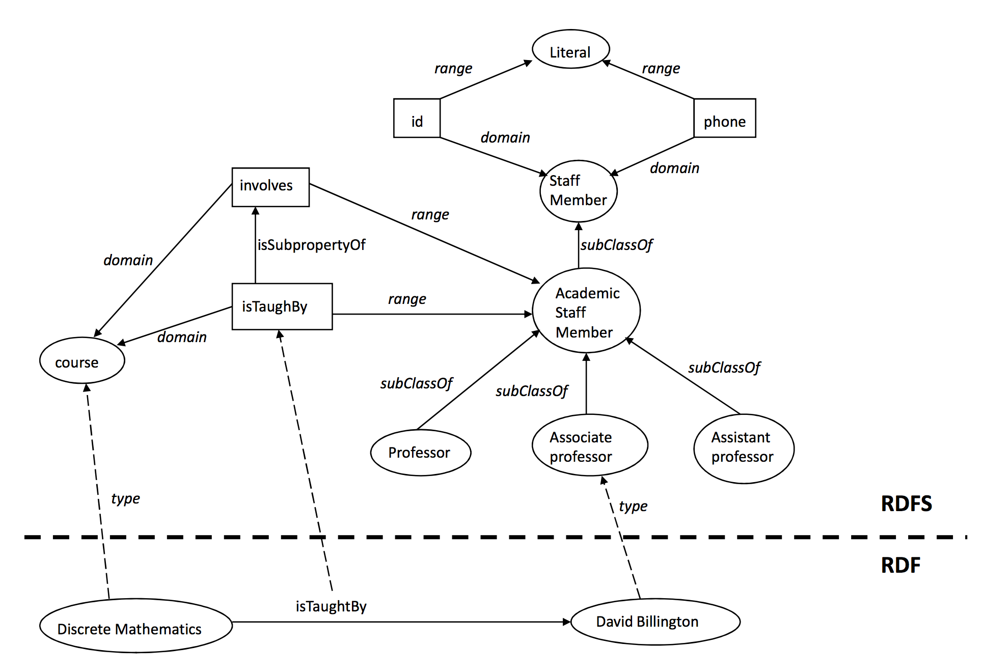
Data and schema
Schema
Data
Syntactically it’s all just RDF. The data part only uses RDF vocabulary and the schema part uses RDFS vocabulary

Slide 25
Ex: University Lecturers – Prefix
<rdf:RDF
xmlns:rdf="http://www.w3.org/1999/02/22-rdf-syntax-ns#" xmlns:rdfs="http://www.w3.org/2000/01/rdf-schema#"
>

Slide 26
Ex: University Lecturers -- Classes
<rdfs:Class rdf:ID="staffMember">
<rdfs:comment>The class of staff members </rdfs:comment>
</rdfs:Class>
<rdfs:Class rdf:ID="academicStaffMember">
<rdfs:comment>The class of academic staff members </rdfs:comment>
<rdfs:subClassOf rdf:resource="#staffMember"/>
</rdfs:Class>
<rdfs:Class rdf:ID="lecturer">
<rdfs:comment> The class of lecturers. All lecturers are academic staff members.
</rdfs:comment>
<rdfs:subClassOf rdf:resource="#academicStaffMember"/>
</rdfs:Class>
<rdfs:Class rdf:ID="course">
<rdfs:comment>The class of courses</rdfs:comment>
</rdfs:Class>

Slide 27
Ex: University Lecturers -- Properties
<rdf:Property rdf:ID="isTaughtBy">
<rdfs:comment>Assigns lecturers to courses. </rdfs:comment>
<rdfs:domain rdf:resource="#course"/>
<rdfs:range rdf:resource="#lecturer"/>
</rdf:Property>
<rdf:Property rdf:ID="teaches">
<rdfs:comment>Assigns courses to lecturers. </rdfs:comment>
<rdfs:domain rdf:resource="#lecturer"/>
<rdfs:range rdf:resource="#course"/>
</rdf:Property>

Slide 28
Ex: University Lecturers -- Instances
<uni:lecturer rdf:ID="949318"
uni:name="Richard Chang"
uni:title="Associate Professor">
<uni:teaches rdf:resource="#CIT1111"/>
<uni:teaches rdf:resource="#CIT3112"/>
</uni:lecturer>
<uni:lecturer rdf:ID="949352"
uni:name="Grigoris Antoniou"
uni:title="Professor">
<uni:teaches rdf:resource="#CIT1112"/>
<uni:teaches rdf:resource="#CIT1113"/>
</uni:lecturer>
<uni:course rdf:ID="CIT1111"
uni:courseName="Discrete Mathematics">
<uni:isTaughtBy rdf:resource="#949318"/>
</uni:course>
<uni:course rdf:ID="CIT1112"
uni:courseName="Concrete Mathematics">
<uni:isTaughtBy rdf:resource="#949352"/>
</uni:course>

Slide 29
Example: A University
<rdfs:Class rdf:ID="lecturer">
<rdfs:comment>
The class of lecturers. All lecturers are academic staff members.
</rdfs:comment>
<rdfs:subClassOf rdf:resource="#academicStaffMember"/>
</rdfs:Class>

Slide 30
Example: A University
<rdfs:Class rdf:ID="course">
<rdfs:comment>The class of courses</rdfs:comment>
</rdfs:Class>
<rdf:Property rdf:ID="isTaughtBy">
<rdfs:comment>
Inherits its domain ("course") and range ("lecturer")
from its superproperty "involves”
</rdfs:comment>
<rdfs:subPropertyOf rdf:resource="#involves"/>
</rdf:Property>

Slide 31
Example: A University
<rdf:Property rdf:ID="phone">
<rdfs:comment>
It is a property of staff members
and takes literals as values.
</rdfs:comment>
<rdfs:domain rdf:resource="#staffMember"/>
<rdfs:range rdf:resource="http://www.w3.org/2000/01/rdf-schema#Literal"/>
</rdf:Property>

Slide 32
RDF and RDFS Namespaces
The RDF, RDFS and OWL namespaces specify some constraints on the ‘languages’
http://www.w3.org/1999/02/22-rdf-syntax-ns#
http://www.w3.org/2000/01/rdf-schema#
http://www.w3.org/2002/07/owl#
Strangely, each uses terms from all three to define its own terms
Don’t be confused: the real semantics of the terms isn’t specified in the namespace files

Slide 33
RDF Namespace
<rdf:RDF
xmlns:rdf="http://www.w3.org/1999/02/22-rdf-syntax-ns#"
xmlns:rdfs="http://www.w3.org/2000/01/rdf-schema#"
xmlns:owl="http://www.w3.org/2002/07/owl#"
xmlns:dc="http://purl.org/dc/elements/1.1/">
<owl:Ontology
rdf:about="http://www.w3.org/2000/01/rdf-schema#"
dc:title="The RDF Schema vocabulary (RDFS)"/>
<rdfs:Class rdf:about="http://www.w3.org/2000/01/rdf-schema#Resource">
<rdfs:isDefinedBy rdf:resource="http://www.w3.org/2000/01/rdf-schema#"/>
<rdfs:label>Resource</rdfs:label>
<rdfs:comment>The class resource, everything.</rdfs:comment>
</rdfs:Class>
…

Slide 34
RDF Namespace in turtle
@prefix rdf: <http://www.w3.org/1999/02/22-rdf-syntax-ns#> .
@prefix rdfs: <http://www.w3.org/2000/01/rdf-schema#> .
@prefix owl: <http://www.w3.org/2002/07/owl#> .
@prefix dc: <http://purl.org/dc/elements/1.1/> .
<http://www.w3.org/1999/02/22-rdf-syntax-ns#>
a owl:Ontology ;
dc:title "The RDF Vocabulary (RDF)" ;
dc:description "This is the RDF Schema for the RDF vocabulary defined in the RDF namespace." .
rdf:type a rdf:Property ;
rdfs:isDefinedBy <http://www.w3.org/1999/02/22-rdf-syntax-ns#> ;
rdfs:label "type" ;
rdfs:comment "The subject is an instance of a class." ;
rdfs:range rdfs:Class ;
rdfs:domain rdfs:Resource .

Slide 35
RDF Namespace example
rdf:Statement a rdfs:Class ;
rdfs:subClassOf rdfs:Resource ;
rdfs:comment "The class of RDF statements." .
rdf:subject a rdf:Property ;
rdfs:domain rdf:Statement ;
rdfs:range rdfs:Resource .
rdf:predicate a rdf:Property ;
rdfs:domain rdf:Statement ;
rdfs:range rdfs:Resource .

Slide 36
RDF Namespace example
This example shows how RDFS terms are used to say something important about the RDF predicate property
<rdf:Property rdf:ID="predicate"
rdfs:comment="Identifies the property of a statement in reified form"/>
<rdfs:domain rdf:resource="#Statement"/>
<rdfs:range rdf:resource="#Property"/>
</rdf:Property>
predicate is a property from a Statement to a Property

Slide 37
RDF Namespace
Define rdf:Resource and rdf:Class as instances of rdfs:Class & rdf:Class as a subclass of rdf:Resource
<rdfs:Class rdf:ID="Resource"
rdfs:comment="The most general class"/>
<rdfs:Class rdf:ID="Class"
rdfs:comment="The concept of classes.
All classes are resources"/>
<rdfs:subClassOf rdf:resource="#Resource"/>
</rdfs:Class>

Slide 38
RDF Namespace
Define rdf:Resource and rdf:Class as instances of rdfs:Class & rdf:Class as a subclass of rdf:Resource
<rdfs:Class rdf:ID="Resource"
rdfs:comment="The most general class"/>
<rdfs:Class rdf:ID="Class"
rdfs:comment="The concept of classes.
All classes are resources"/>
<rdfs:subClassOf rdf:resource="#Resource"/>
</rdfs:Class>
rdfs: Class
rdf:type
rdf: Resource
rdf:type
rdfs:subclass
rdf: Class

Slide 39
RDFS Namespace
@prefix rdf: <http://www.w3.org/1999/02/22-rdf-syntax-ns#> .
@prefix rdfs: <http://www.w3.org/2000/01/rdf-schema#> .
…
<http://www.w3.org/2000/01/rdf-schema#> a owl:Ontology ;
dc:title "The RDF Schema vocabulary (RDFS)" .
rdfs:Resource a rdfs:Class ;
rdfs:comment "The class resource, everything." .
rdfs:Class a rdfs:Class ;
rdfs:subClassOf rdfs:Resource .
rdfs:subClassOf a rdf:Property ;
rdfs:isDefinedBy <http://www.w3.org/2000/01/rdf-schema#> ;
rdfs:label "subClassOf" ;
rdfs:comment "The subject is a subclass of a class." ;
rdfs:range rdfs:Class ;
rdfs:domain rdfs:Class .
…

Slide 40
Namespaces vs. Semantics
Consider rdfs:subClassOf
The namespace specifies only that it applies to classes and has a class as a value
The meaning of being a subclass not specified
The meaning cannot be expressed in RDF
If it could RDF Schema would be unnecessary
External definition of semantics required
Respected by RDF/RDFS processing software

Slide 41
RDFS vs. OO Models
In OO models, an object class defines the properties that apply to it
Adding a new property means modifying the class
In RDF, properties defined globally and not encapsulated as attributes in class definitions
We can define new properties w/o changing class
Properties can have properties
:mother rdfs:subPropertyOf :parent; rdf:type :FamilyRelation.
But: can’t narrow domain & range of properties in a subclass

Slide 42
Example
@prefix rdf: <http://www.w3.org/1999/02/22-rdf-syntax-ns#> .
@prefix rdfs: <http://www.w3.org/2000/01/rdf-schema#> .
@prefix bio: <http://example.com/biology#> .
bio:Animal a rdfs:Class.
bio:offspring a rdfs:Property;
rdfs:domain bio:Animal;
rdfs:range bio:Animal.
bio:Human rdfs:subClassOf bio:Animal.
bio:Dog rdfs:subClassOf bio:Animal.
:fido a bio:Dog.
:john a bio:Human;
bio:offspring :fido.

Slide 43
Ontology and Data
Let’s follow best practice and separate our ontology (i.e., schema) file from the data
# A simple Biology ontology
@prefix rdf: <http://www.w3.org/1999/02/22-rdf-syntax-ns#> .
@prefix rdfs: <http://www.w3.org/2000/01/rdf-schema#> .
@prefix bio: <http://example.com/biology#> .
bio:Animal a rdfs:Class.
bio:offspring a rdfs:Property;
rdfs:domain bio:Animal;
rdfs:range bio:Animal.
bio:Human rdfs:subClassOf bio:Animal.
bio:Dog rdfs:subClassOf bio:Animal.
# Some biological data
@prefix rdf: <http://www.w3.org/1999/02/22-rdf-syntax-ns#> .
@prefix rdfs: <http://www.w3.org/2000/01/rdf-schema#> .
@prefix bio: <http://example.com/biology#> .
@prefix : <http://finin.org/example/#> .
# fido’s a dog!
:fido a bio:Dog.
# john’s human & has offspring fido
:john a bio:Human;
bio:offspring :fido.

Slide 44
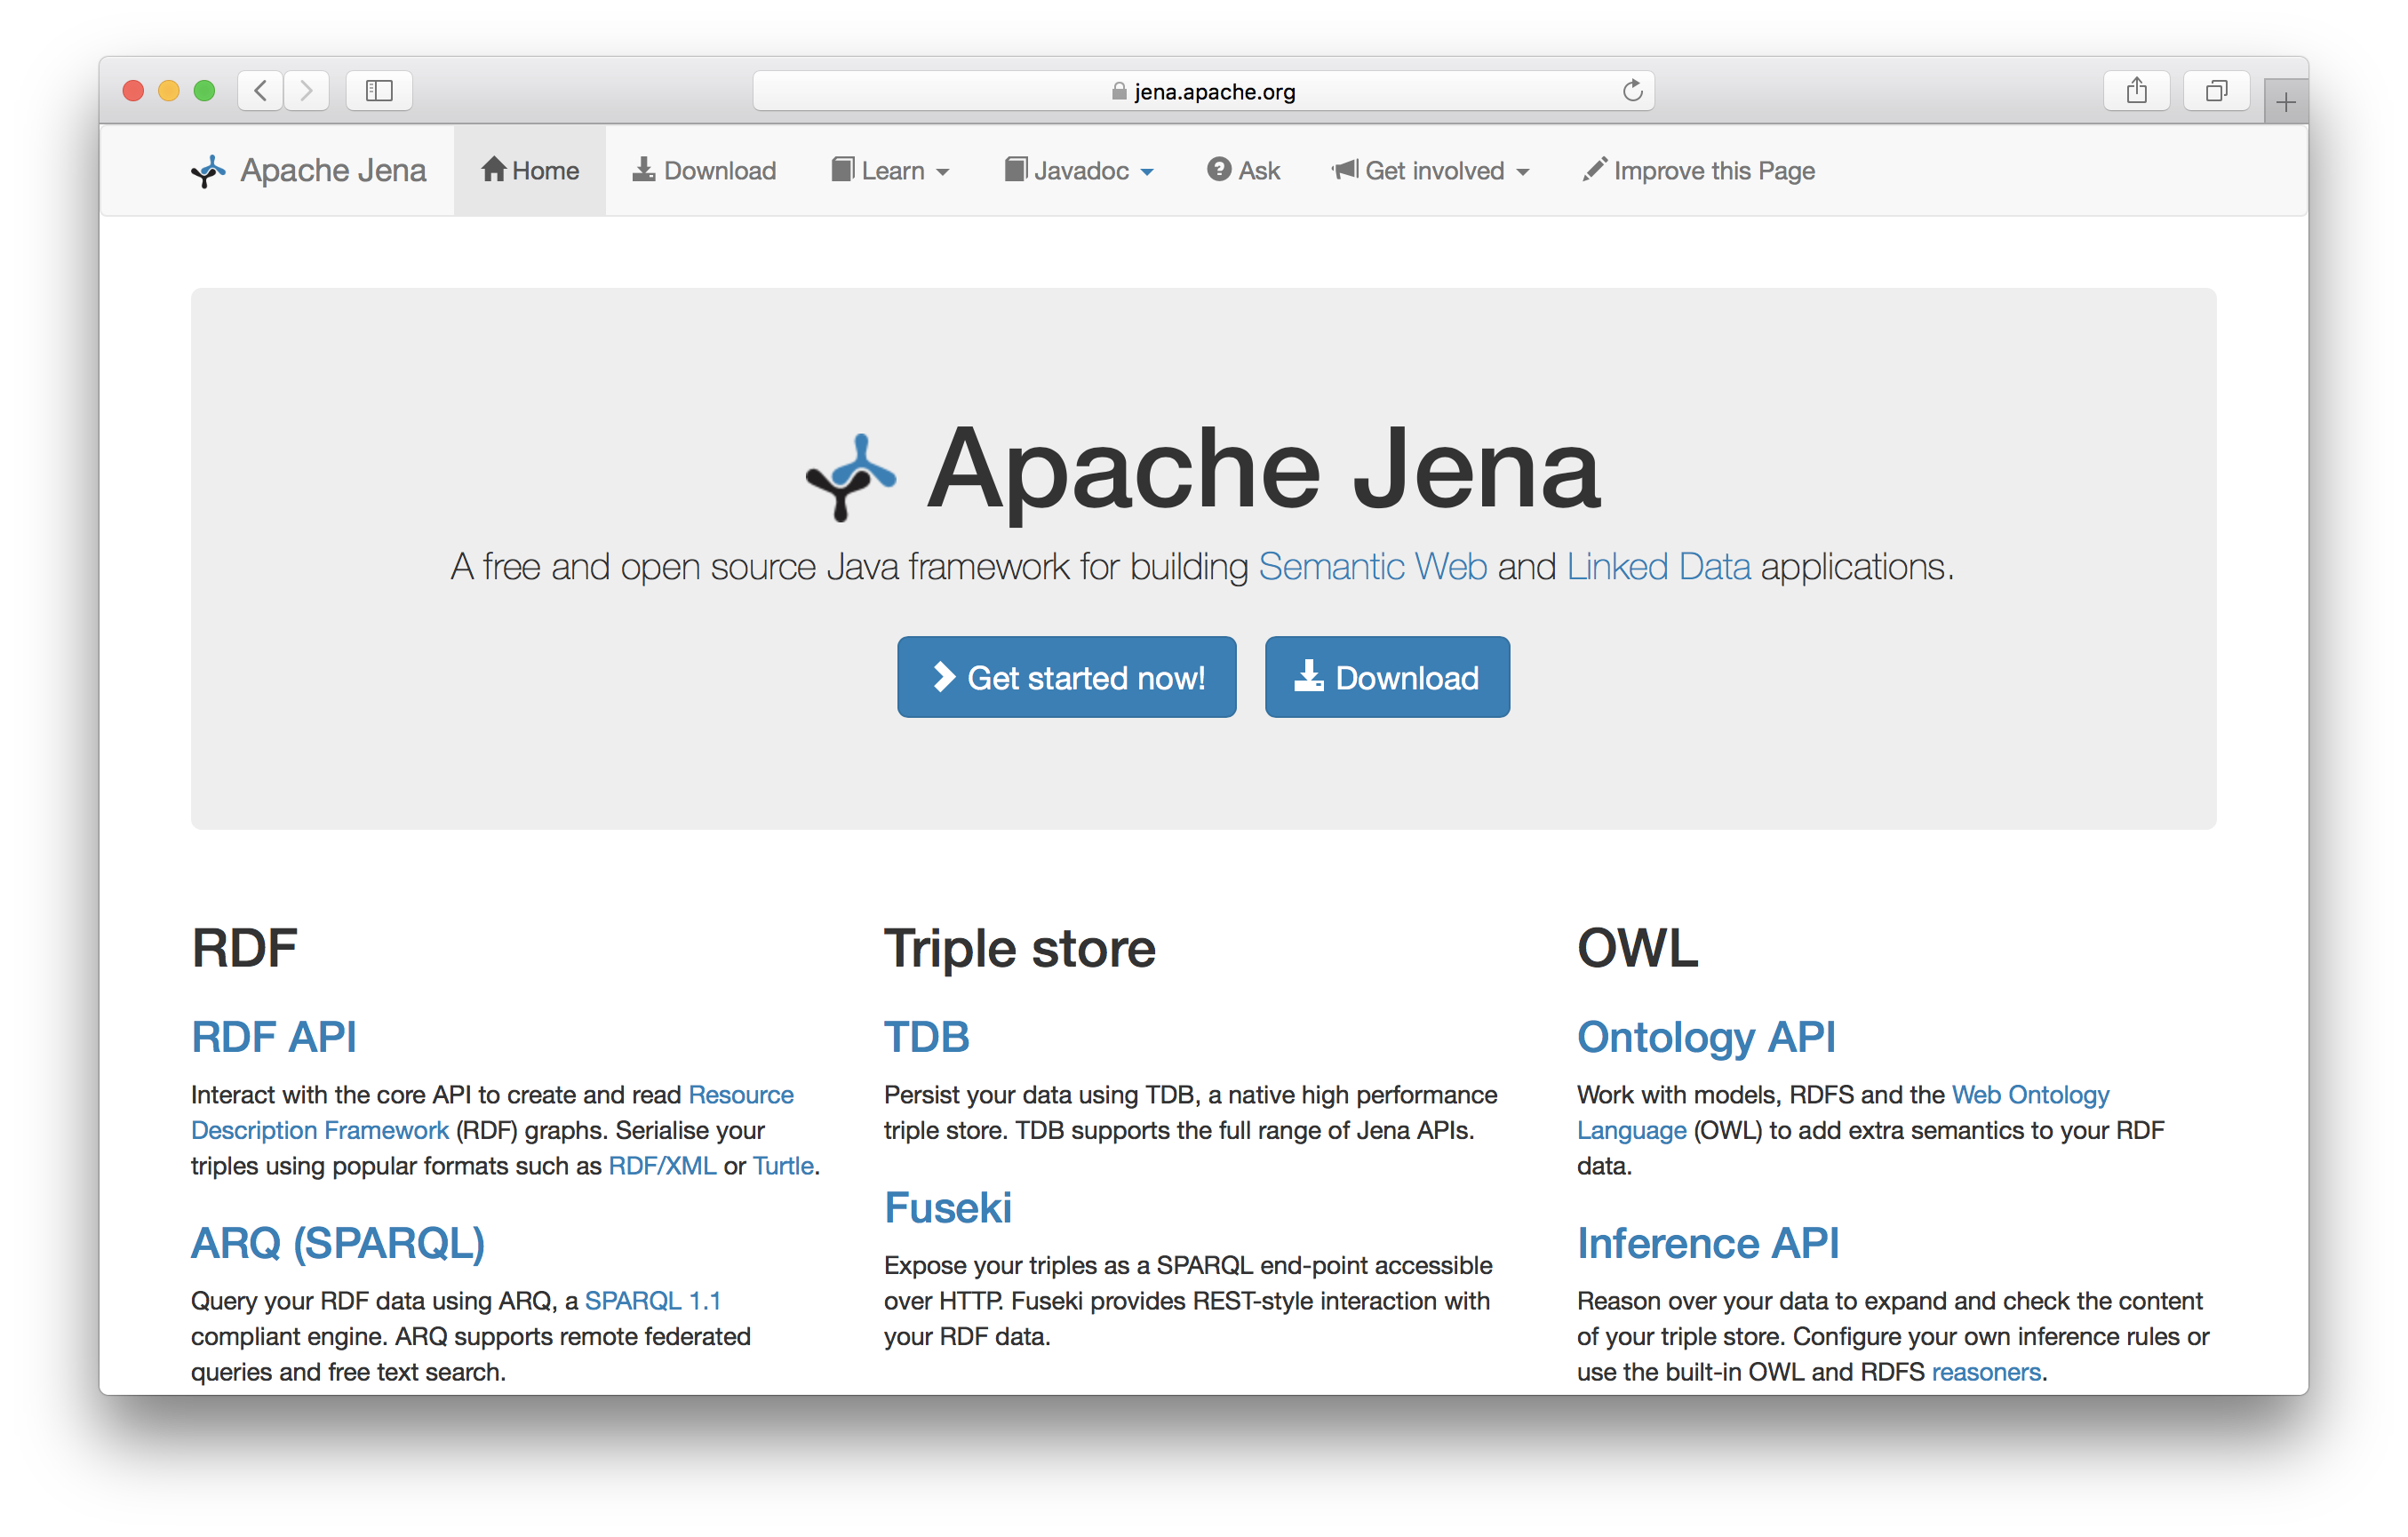
Apache Jena
Apache Jena is a suite of high-quality, well-maintained, opensource tools in Java for semantic web technology

Slide 45
Jena’s riot command
Jena has a set of command line tools
Riot can convert between serializations and also do simple rdfs inference
Let’s try it on the example
riot --rdfs=bio0.ttl --formatted=ttl mybio0.ttl

Slide 46
Riot rdfs inference
bio> riot --rdfs=bio0.ttl --formatted=ttl mybio0.ttl
@prefix : <http://finin.org/example/#> .
@prefix rdf: <http://www.w3.org/1999/02/22-rdf-syntax-ns#> .
@prefix rdfs: <http://www.w3.org/2000/01/rdf-schema#> .
@prefix bio: <http://example.com/biology#> .
:fido rdf:type bio:Dog ;
rdf:type bio:Animal .
:john rdf:type bio:Human ;
rdf:type bio:Animal ;
bio:offspring :fido ;
rdf:type bio:Animal .
:fido rdf:type bio:Animal .
bio>

Slide 47
Example
@prefix rdf: <http://www.w3.org/1999/02/22-rdf-syntax-ns#> .
@prefix rdfs: <http://www.w3.org/2000/01/rdf-schema#> .
@prefix bio: <http://example.com/biology#> .
bio:Animal a rdfs:Class.
bio:offspring a rdfs:Property;
rdfs:domain bio:Animal;
rdfs:range bio:Animal.
bio:Human rdfs:subClassOf bio:Animal.
bio:Dog rdfs:subClassOf bio:Animal.
:fido a bio:Dog.
:john a bio:Human;
bio:offspring :fido.
There is no way to say that the offspring of humans are humans and the offspring of dogs are dogs.

Slide 48
Example
Bio:child rdfs:subPropertyOf bio:offspring;
rdfs:domain bio:Human;
rdfs:range bio:Human.
Bio:puppy rdfs:subPropertyOf bio:offspring;
rdfs:domain bio:Dog;
rdfs:range bio:Dog.
:john bio:child :mary.
:fido bio:puppy :rover.
What do we know after each of the last two triples are asserted?

Slide 49
Example
Bio:child rdfs:subPropertyOf bio:offspring;
rdfs:domain bio:Human;
rdfs:range bio:Human.
Bio:puppy rdfs:subPropertyOf bio:offspring;
rdfs:domain bio:Dog;
rdfs:range bio:Dog.
:john bio:child :mary.
:fido bio:puppy :rover.
Suppose we also assert:
:john bio:puppy :rover
:john bio:child :fido

Slide 50
Not like types in OO systems
Classes differ from types in OO systems in how they are used
They are not constraints on well-formedness as in most programming languages
Lack of negation & open world assumption in RDF+RDFS makes detecting such contradictions impossible!
Can’t say that Dog and Human are disjoint classes
Not knowing any individuals who are both doesn’t mean it’s not possible

Slide 51
No disjunctions or union types
What does this mean?
bio:Human rdfs:subClassOf bio:Animal.
bio:Cat rdfs:subClassOf bio:Animal.
bio:Dog rdfs:subClassOf bio:Animal.
bio:hasPet a rdfs:Property;
rdfs:domain bio:Human;
rdfs:range bio:Dog;
rdfs:range bio:Cat.

Slide 52
No disjunctions or union types
What does this mean?
Bio:Human rdfs:subClassOf bio:Animal.
bio:Cat rdfs:subClassOf bio:Animal.
Bio:Dog rdfs:subClassOf bio:Animal.
bio:hasPet a rdfs:Property;
rdfs:domain bio:Human;
rdfs:range bio:Dog;
rdfs:range bio:Cat.
Consider adding:
:john bio:hasPet :spot

Slide 53
No disjunctions or union types
What does this mean?
bio:Human rdfs:subClassOf bio:Animal.
bio:Cat rdfs:subClassOf bio:Animal.
bio:Dog rdfs:subClassOf bio:Animal.
bio:hasPet a rdfs:Property;
rdfs:domain bio:Human;
rdfs:range bio:Dog;
rdfs:range bio:Cat.
:john bio:hasPet :spot
=>
:john a bio:Human, bio:Animal.
:spot a bio:Dog, bio:Cat, bio:Animal.

Slide 54
What do we want to say?
Many different possibilities
Only a dog or cat can be an object of hasPet property
Dogs and cats and maybe other animals are possible as pets
Dogs and cats and maybe other things, not necessarily animals, are possible as pets
All dogs and all cats are pets
It’s possible for some dogs and some cats to be pets
Not all of these can be said in RDF+RDFS
We can express all of these in OWL (I think)

Slide 55
What do we want to say?
property
animal
subclass
pet
subclass
hasPet
subclass
subclass
subclass
subclass
subclass
range
human
dog
cat
domain

Slide 56
What do we want to say?
property
animal
subclass
pet
subclass
hasPet
subclass
subclass
subclass
subclass
subclass
range
human
dog
cat
domain
john
hasPet
spot

Slide 57
What do we want to say?
property
animal
subclass
pet
subclass
hasPet
subclass
subclass
subclass
subclass
subclass
range
human
dog
cat
domain
:john bio:hasPet :spot
=>
:john a bio:Human, bio:Animal.
:spot a bio:Pet, bio:Animal.
All dogs are pets
All cats are pets
All pets are animals
john
hasPet
spot

Slide 58
What do we want to say?
property
animal
subclass
pet
subclass
hasPet
subclass
subclass
subclass
subclass
subclass
range
human
dog
cat
domain
:john bio:hasPet :spot
=>
:john a bio:Human, bio:Animal.
:spot a bio:Pet, bio:Animal.
All dogs are pets
All cats are pets
All pets are animals

Slide 59
What do we want to say?
property
animal
subclass
pet
subclass
hasPet
subclass
subclass
subclass
subclass
subclass
range
human
dog
cat
domain
type
type
type
type
john
hasPet
spot

Slide 60
Classes and individuals are not disjoint
In OO systems a thing is either a class or object
Many KR systems are like this also
Not so in RDFS
bio:Species rdf:type rdfs:Class.
bio:Dog rdf:type rdfs:Species;
rdfs:subClassOf bio:Animal.
:fido rdf:type bio:Dog.
Adds richness to language but causes problems
In OWL DL you can’t do this
OWL has it’s own notion of a Class, owl:Class
rdf:type links an individual to a class it belongs to
rdfs:subClass links a class to a super-class it is part of

Slide 61
Inheritance is simple
No defaults, overriding, shadowing
What you say about a class is necessarily true of all sub-classes
A class’s properties are not inherited by its members
Can’t say “Dog’s are normally friendly” or even “All dogs are friendly”
Meaning of the Dog class is a set of individuals
Sets cannot be friendly

Slide 62
Set Based Model Theory Example
World
Model
Interpretation
Δ
Daisy isA Cow
Cow kindOf Animal
Mary isA Person
Person kindOf Animal
a
Z123ABC isA Car
b
Mary drives Z123ABC
{... list of facts about individuals ...}

Slide 63
Is RDF(S) better than XML?
Q: For a specific application, should I use XML or RDF?
A: It depends…
XML's model is
a tree, i.e., a strong hierarchy
applications may rely on hierarchy position
relatively simple syntax and structure
not easy to combine trees
RDF's model is
a loose collections of relations
applications may do “database”-like search
not easy to recover hierarchy
easy to combine relations in one big collection
great for the integration of heterogeneous information

Slide 64
RDFS too weak to describe resources in detail
No localised range and domain constraints
Can’t say range of hasChild is person when applied to persons and elephant when applied to elephants
No existence/cardinality constraints
Can’t say all instances of person have a mother that is a person, or that persons have exactly two parents
No transitive, inverse or symmetrical properties
Can’t say isPartOf is a transitive property, hasPart is the inverse of isPartOf or that touches is symmetrical
We need RDF terms providing these and other features: this is where OWL comes in

Slide 65
RDF Conclusions
Simple data model based on a graph, independent of serializations (e.g., XML or N3)
Has a formal semantics providing a dependable basis for reasoning about the meaning of RDF expressions
Has an XML serialization, can use XML schema datatypes
Open world assumption: anyone can make statements about any resource
RDFS adds vocabulary with well defined semantics (e.g., Class, subClassOf, etc.)
OWL addresses some of RDFS’s limitations adding richness (and complexity)

